Slide 1















The paradigm of Synihiseis
Applied inclusion
in a systemic, dialogical, educational and psychotherapeutic centre
Ilias Gotsis, Eva Filanthropopoulou,
Erofili Dagalidou, Katerina Katrantzi,
Antigoni Matsouka, Areti Tsikrika,
Anna Kiapoka

Slide 2

The epistemological context of inclusion

Slide 3


The ethics of inclusion
in psychotherapy
“The ethical act is an act of connection:
A connection with the Other, a connection with a community, a connection with a society and, ultimately, a connection with the human species”.
Morin (2013, p. 38)

Slide 4

Applied inclusion
in a systemic Centre
“How did man invent for himself the value judgments of good and evil? And what value do they have in themselves? Have they so far restrained or promoted the development of humanity? Are they a sign of poverty, impoverishment, degeneration of life? Or, conversely, do they betray fullness, strength, the will to live, courage, certainty, its future? —On this I found and dared to give many kinds of answers, I made distinctions between eras, peoples, levels of individuals; I specified my problem, and from the answers new questions, inquiries, speculations, possibilities were born: until in the end I discovered a land of my own, a soil of my own, an entire hidden, flourishing, blossoming world, like a secret garden whose existence no one was meant to suspect.”
(Nietzsche: On Morality)

Slide 5

ethics and inclusion
The ethics of inclusion in psychotherapy accepts diversity and variety, otherness, uncertainty and fluidity as unavoidable —yet at the same time desirable— constituent elements of the psychotherapeutic process.

Slide 6

inclusion
Inclusion is an ongoing transformative process, especially once we speak of landscapes of inclusion which, like any landscape, are in constant change.
Inclusion lies at the core of Buber’s philosophy, which transcends mere empathy and forms the basis of the “I–You” relationship. This relationship is an encounter in which inclusion serves as a bridge linking two different worlds. Under this condition, people meet at a level deeper than words, where silence speaks its own language.
Through inclusion, Buber invites us to take a bold leap toward the Other, to be transparent and authentic. Inclusion allows us not only to understand the other but to experience the world through his or her eyes, while simultaneously maintaining our own perspective.

Slide 7

inclusion
When inclusion is present in the “I–You” relationship, we simultaneously recognise the uniqueness of the other and our common human nature. In contrast, the absence of inclusion leads to the “I–It” relationship, where the other is reduced to a mere instrument, losing the essence of human connection.
As Matthew Martin and Eric W. Cowan (2019) point out: “Inclusion is the ability to understand the experience of the other so deeply, almost as if I am experiencing it myself, without losing my distinctiveness. A daring oscillation that presupposes the most intense involvement of your existence in the life of the other.”

Slide 8
inclusion
IN THE SYSTEMIC, SYNTHETIC,
MODEL OF APPRECIATIVE INQUIRY
Inclusion resembles empathy but transcends it, for it is neither merely an act nor a feeling; it is a fundamental existential and ethical stance that is translated into action, a deliberate orientation toward the experience of the Other.
At S.S.M.A.I. we have focused on as it constitutes a basic dimension of our philosophy. We have sought to engage in dialogue with the definition provided by Buber. This dialogue is an ongoing process and concerns both the inclusion of our own internal invisible, oppressed, unspoken or forbidden voices, our feelings and our marginalised aspects, and those of the Others, who always constitute a form of otherness.

Slide 9
inclusion
IN THE SYSTEMIC, SYNTHETIC,
MODEL OF APPRECIATIVE INQUIRY
Inclusion, within the context of S.S.M.A.I., is defined as:
“The recognition and connection with our polyphonic self, with our internal voices, the expansion and transformation of ourselves and of the frameworks in order to co‑construct a common space where our theories, stories and narratives can coexist with those of others. In this common space, the resources that emerge from the encounter and dialogue with the Other feed and enrich our own resources. Likewise, our desires and dreams communicate with those of the Others, and actions and relational experiences enrich, modify and transform meaning, language and perspective. In this ‘community of resources, desires, dreams and practices’, individual identities neither merge into the collectivity nor pseudo‑differentiate through an alienated autonomy; rather, subjects are conceived as persons who maintain an internal unity and coherence and construct their identity through dialogicality and polyphony.”

Slide 10

inclusion
IN THE S.S.M.A.i.
Inclusion, as a transformative process, also involves creating new metaphors capable of defining reality. As Lakoff and Johnson point out (cited by Pollard, 2011), metaphors are not merely linguistic figures but conceptual systems that shape how we perceive, think and act. When we speak of “resources”, “desires”, “dreams” and “communities”, we use metaphorical concepts that reflect specific values and perspectives. Inclusion entails the conscious selection of metaphors that promote mutual understanding, empathy and co‑creation of meaning, rather than imposing predetermined categories and interpretations.

Slide 11
inclusion
aNd dialogicality
Within this framework, since inclusion is recognised as a deeply existential and ethical stance that emerges through dialogue, it is crucial to approach dialogicality not merely as a mode of communication but as a foundation of human existence and identity formation. Inclusion, from this perspective, may be seen as the ethical and existential precondition of dialogue. There is no dialogicality without the recognition and incorporation of all voices, even those that remain silent, marginalised or excluded. Inclusion thus functions as the mechanism that allows dialogue to remain alive, open and substantial; it enriches the dialogue and simultaneously ensures the person’s capacity to construct their identity within the relationship. This view is affirmed by Mikhail Bakhtin’s position that dialogue is an ontological concept linked to human existence. ‘Ultimately the existence of a person is also dialogue’)” (Dufva, 1998; Bakhtin, 1981; Karatsinidou, 2006: 75).

Slide 12
Applied inclusion
in a systemic Centre
In a reality characterized by fluidity, social alienation, lack of communication and complexity, connecting with as many voices of our polyphonic selves as possible, meeting, communicating and connecting with the excluded voices both internally and externally has been our basic vision for the creation of Synihiseis,
a space of mutual respect and dignity, aiming at the emergence and connection of all our strengths, within a framework of security and freedom.

Slide 13
Applied inclusion
in a systemic Centre
In this context, two groups of trainees were created, coordinated by trainers from the centre:
The first was about deepening the understanding of sexuality and
the second about studying the effects of heteronormativity in psychotherapy and highlighting the importance of inclusion.
The participants worked for about a year and at the end of the year they designed and implemented relevant experiential workshops with their co-trainees.
The results of these training activities were very important for the whole community of Synihiseis, highlighting the importance of horizontal, democratic, inclusive education.

Slide 14
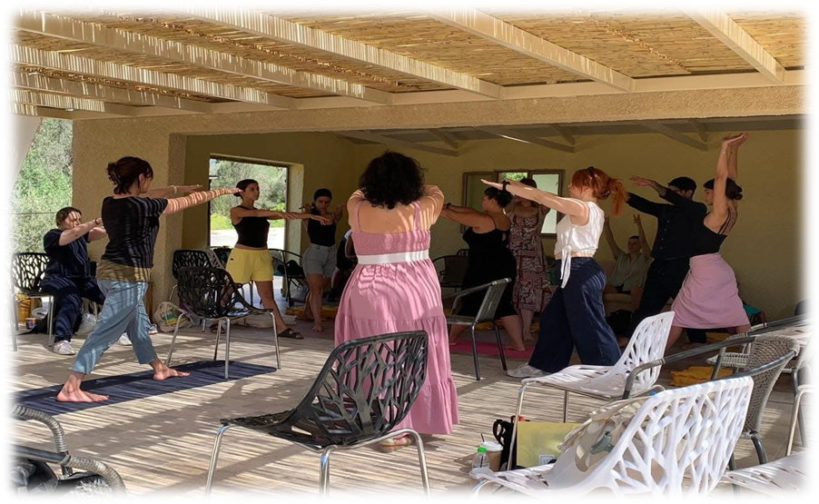
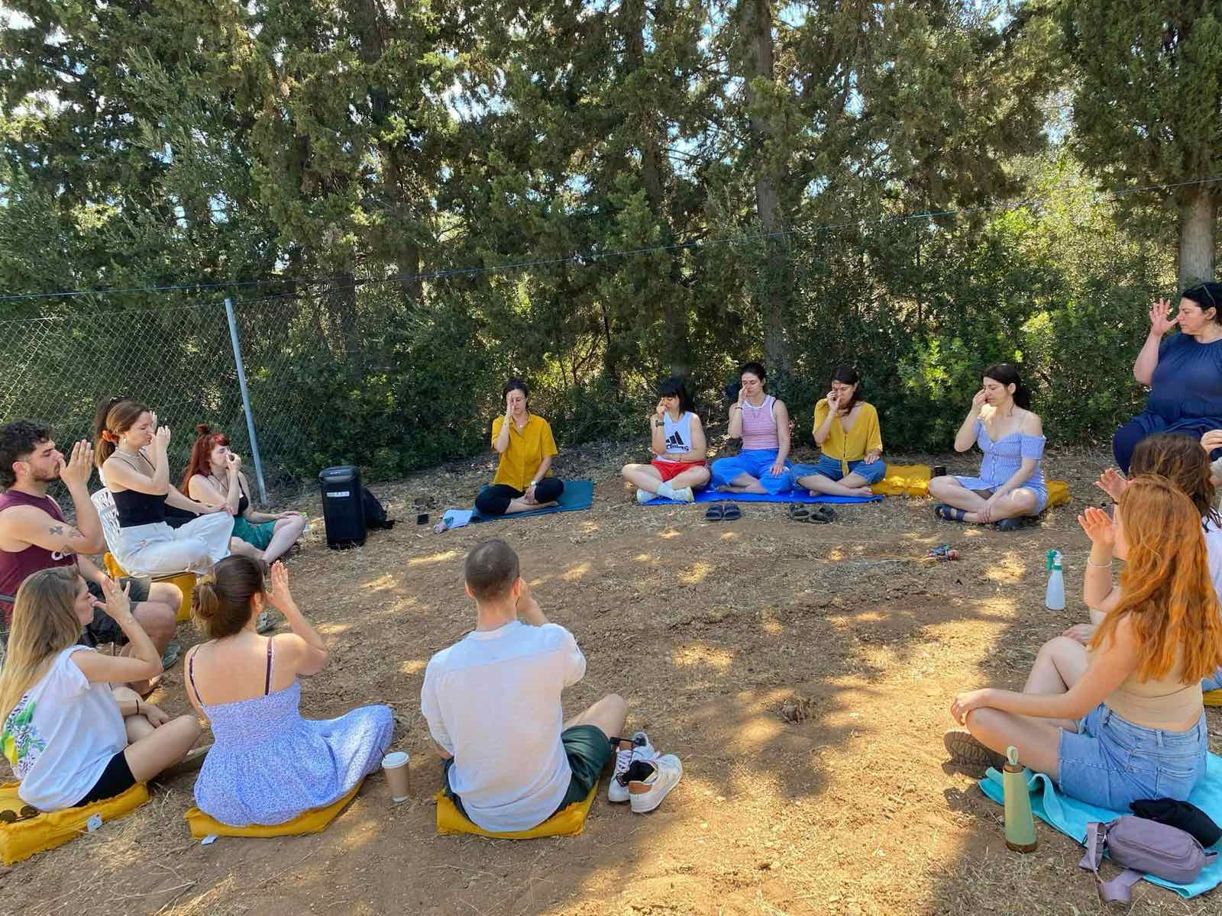
Applied inclusion
in a systemic Centre

Slide 15
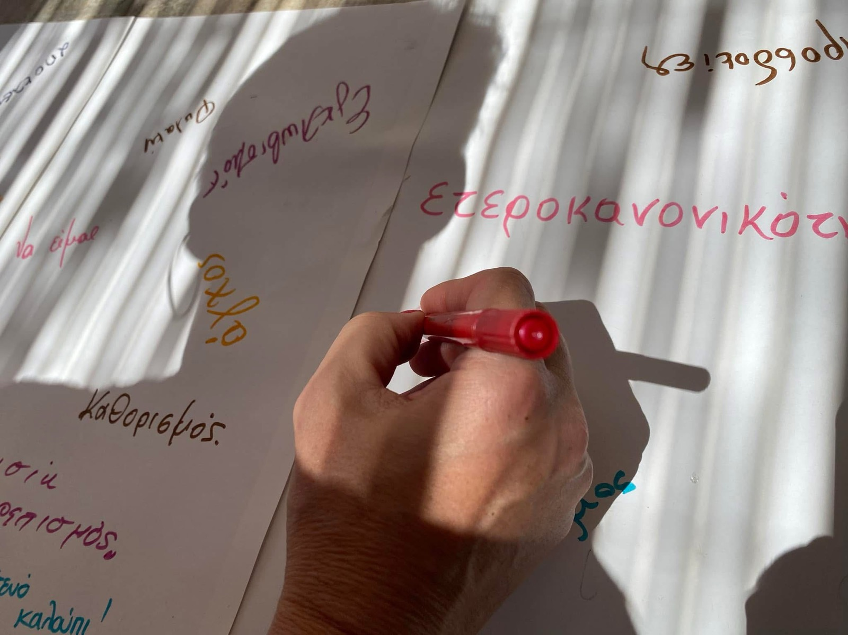
studying the effects of heteronormativity in psychotherapy
Inclusion, fluidity, spectrum
As fundamental concepts of a new psychotherapeutic stance—a stance that takes shape both within and beyond the session, in the very way we exist together.
Not as terms of “political correctness”.
.

Slide 16
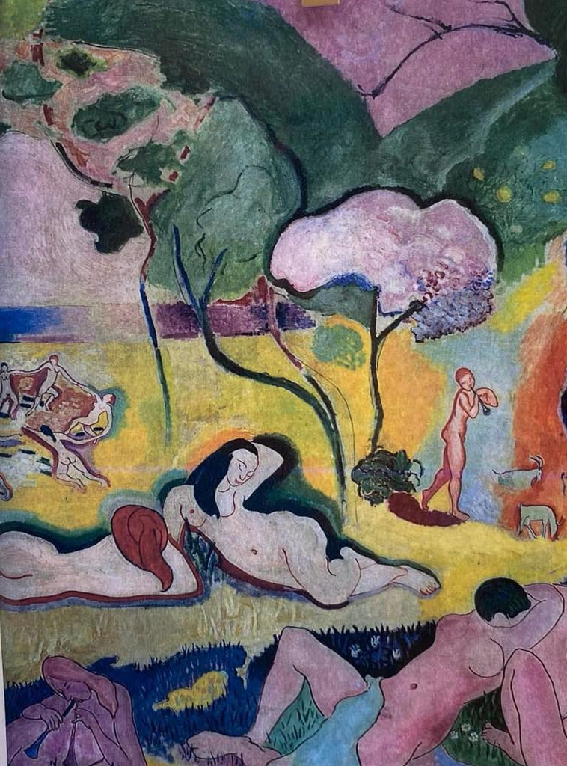
Inclusion, fluidity, spectrum
Inclusion: not merely the acceptance of the “other,” but the active recognition and welcoming of otherness, without limits or exclusions.
Fluidity: the recognition that identity emotions, and relationships are not static but continuously move, transform, and emerge in the flow of life.
Spectrum: the departure from binary, absolute thinking; the understanding that human experiences and expressions unfold along a continuum, with countless shades between the extremes.

Slide 17
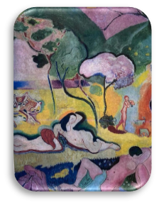
studying the effects of heteronormativity in psychotherapy
Inclusion, fluidity, spectrum
This new stance is not confined to “proper” language but becomes an existential positioning: a way of being-with the other, making space for complexity, and seeing the person as process rather than fixed category...

Slide 18
From Acceptance to Inclusion
In our time, we have grown accustomed to the term acceptance.
Yet acceptance is not identical with inclusion. It presupposes it, but does not exhaust it.
Acceptance carries within it an hierarchical position: I accept something or someone from a place of relative safety or “normality.”
Inclusion, on the other hand, dissolves hierarchy: I do not stand opposite the Other, but beside them.
We are co-diners at the same table of experience.

Slide 19
Worldviews and the Evolution of Inclusion in the Greek Context
If we look at how inclusion appears over time through different worldviews, we encounter an intriguing narrative:
In the traditional worldview
The community and the collective hold primacy
What is different is experienced as a threat
“Inclusion” takes the form of hospitality—yet on terms of subordination and assimilation, not equality
Notes:
The identity is collective

Slide 20
Worldviews and the Evolution of Inclusion in the Greek Context
In the modern period, after the Junta
Concepts such as rights, minority, and racism emerge
The individuals claim space through their characteristics, though not yet as uniquenesses
Science provides discourse, but often through rigid identities

Slide 21
Worldviews and the Evolution of Inclusion in the Greek Context
In the postmodern era
Fluidity emerges
Stable structures are questioned
Small narratives prevail
The notion of stigma enters the table, along with
A more substantial conversation about what it belonging means

Slide 22
Fluidity and Spectrum:
The Other as Our Mirror
In this context, fluidity and spectrum are not merely psychological or social categories. They are modes of existence.
Identity is not something we possess, but something that happens between ourselves and others.
Yet this also brings tremors.

Slide 23
Fluidity and Spectrum:
The Other as Our Mirror
At the collective level, we often witness a return to the traditional, as a reaction to the unknown.
At the individual level, we see regression, anxiety, division.
Fluidity requires inner foundations, and when these are absent, it leads to confusion.

Slide 24
Fluidity and Spectrum:
The Other as Our Mirror
Inclusion in the Therapeutic Relationship
How is space created for lived experience within therapy?
Space that is bodily, emotional, cultural?

Slide 25
Fluidity and Spectrum:
The Other as Our Mirror
Inclusion in the Therapeutic Relationship
The challenge is for experience to be heard and fealed
without the gaze of authority,
without the filters of what is “normal”,
“proper”,
or “therapeutically correct”.

Slide 26
Fluidity and Spectrum:
The Other as Our Mirror
Inclusion in the Therapeutic Relationship
Inclusion in psychotherapy is not a technique.
It is a stance:
the capacity to remain within uncertainty
to endure the fluidity of the other and of oneself
to co-create a space where every voice has a place

Slide 27
Fluidity and Spectrum: The Other as Our Mirror
Inclusion in the Therapeutic Relationship
Conclusions
Inclusion is not merely a social demand.
It is a transformative path.
It calls us:
from blindness to visibility
from normality to polyphony
from “I belong if…” to “we all belong, as we are”

Slide 28

Fluidity and Spectrum: The Other as Our Mirror
Inclusion in the Therapeutic Relationship
Conclusions
How much space do we hold within us for the voices that do not resemble our own?
For perhaps it is there that therapy begins — and inclusion as well

Slide 29

Inclusion in a systemic Centre
DEFINITIONS SHAPED THROUGH DIALOGUE WITH TRAINEES
Inclusion is the transformative process that leads both the individual and the group from blindness to visibility, through the conscious choice and recognition of the self’s polyphony, accompanied by continuous reflection on what is acknowledged and what is excluded.

Slide 30

Inclusion in a systemic Centre
DEFINITIONS SHAPED THROUGH DIALOGUE WITH TRAINEES
Inclusion is the equitable, relational mode of coexistence in which the otherness of each individual connects with other othernesses, within a framework of mutual respect for perceptions and thoughts, so that belonging promotes freedom.

Slide 31
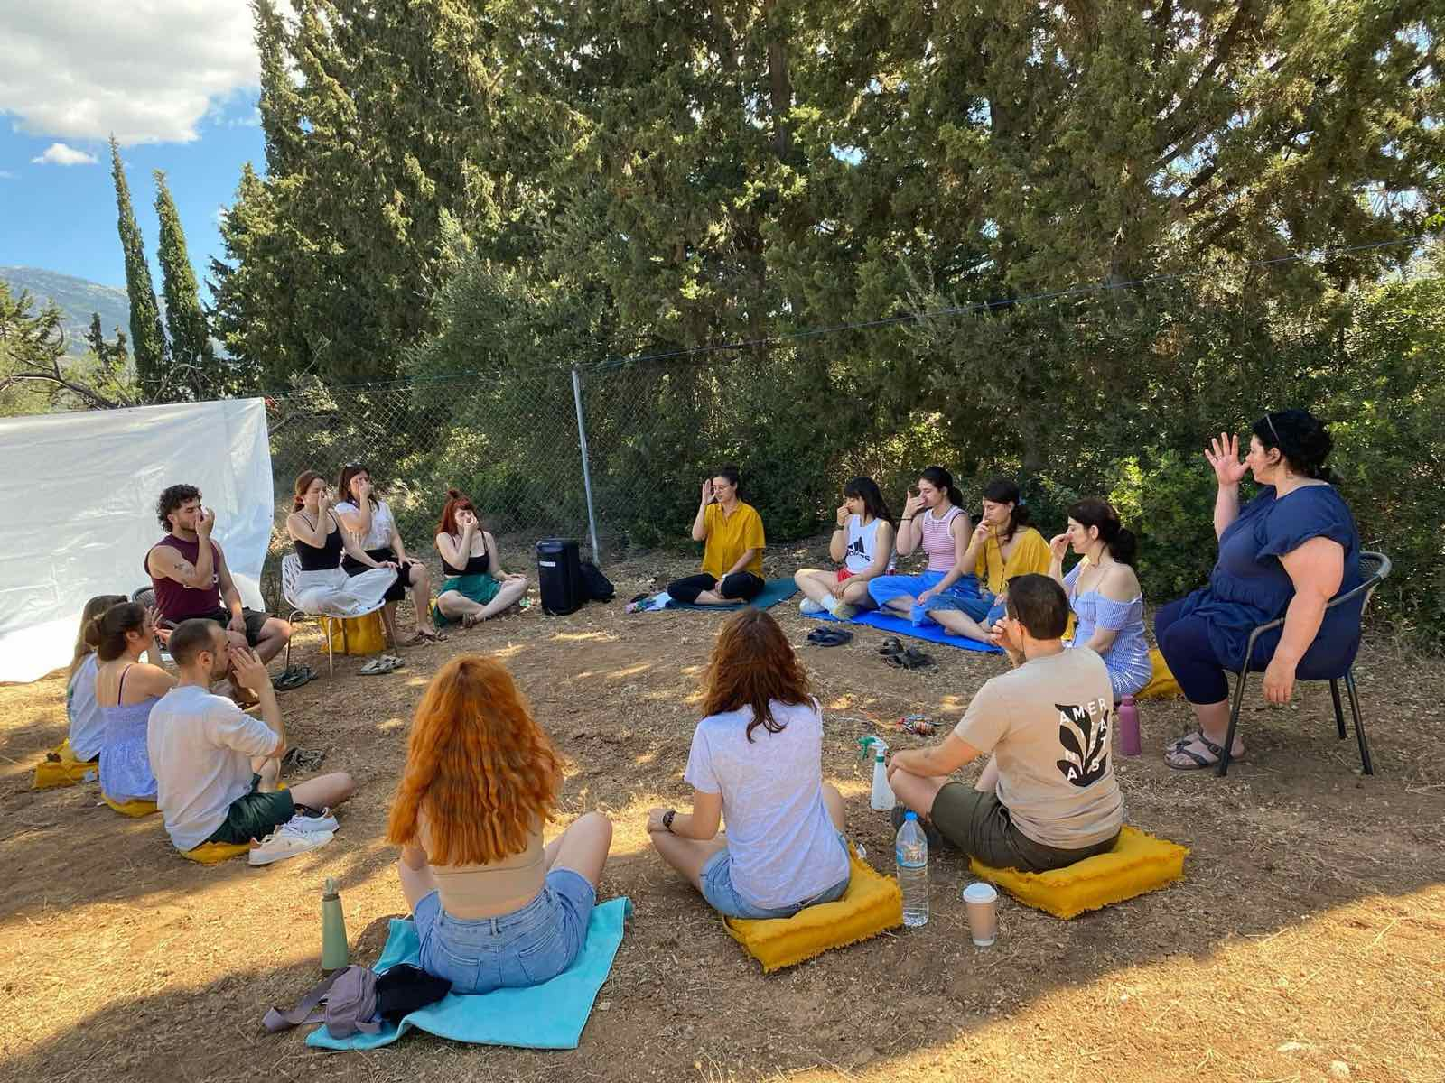
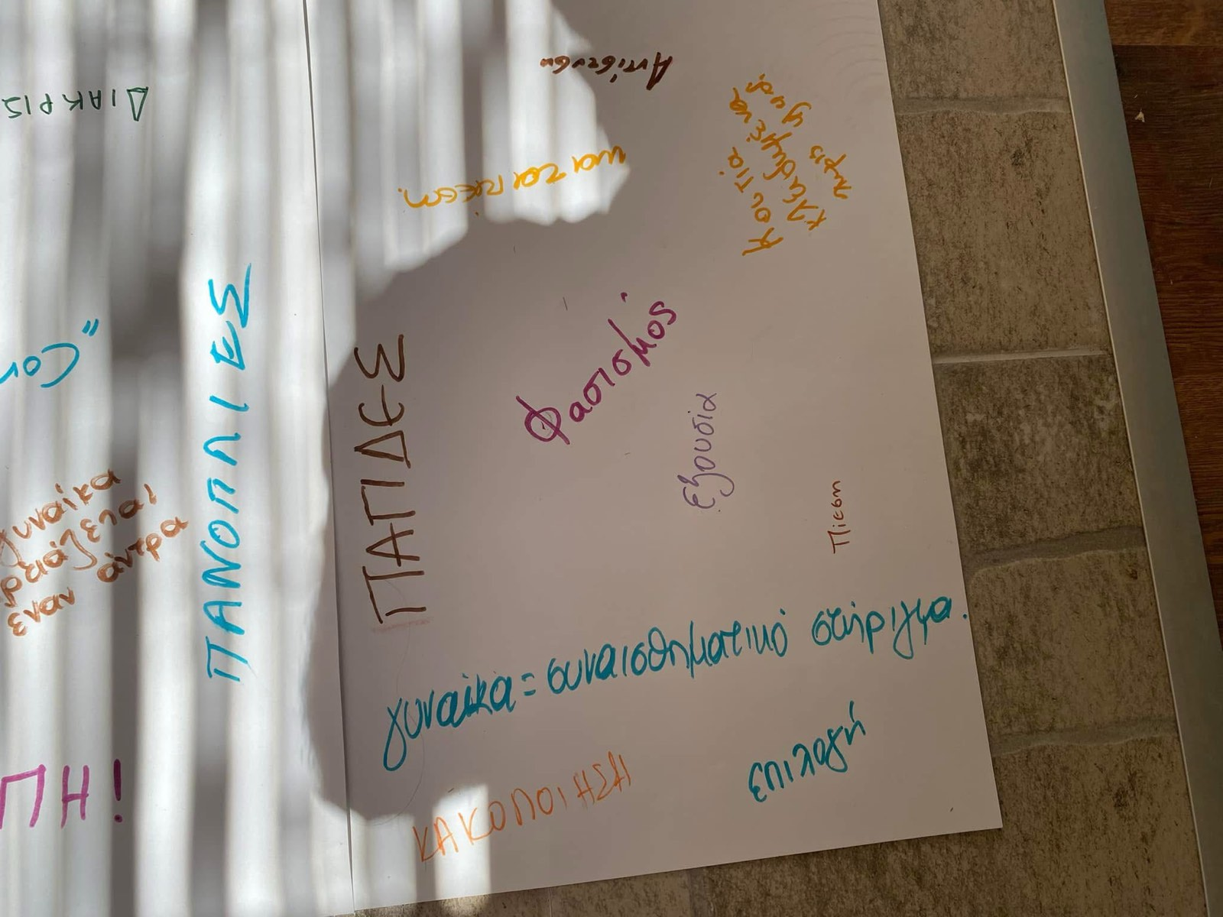
Applied inclusion
in a systemic Centre

Slide 32
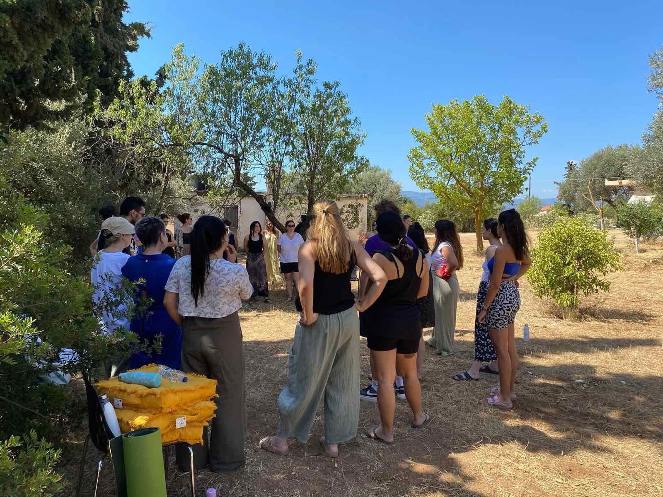
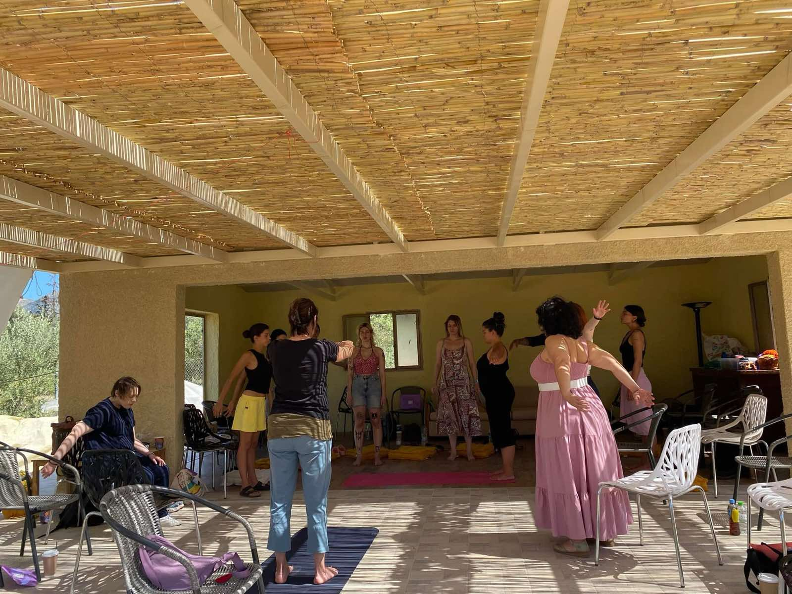
Applied inclusion
in a systemic Centre

Slide 33
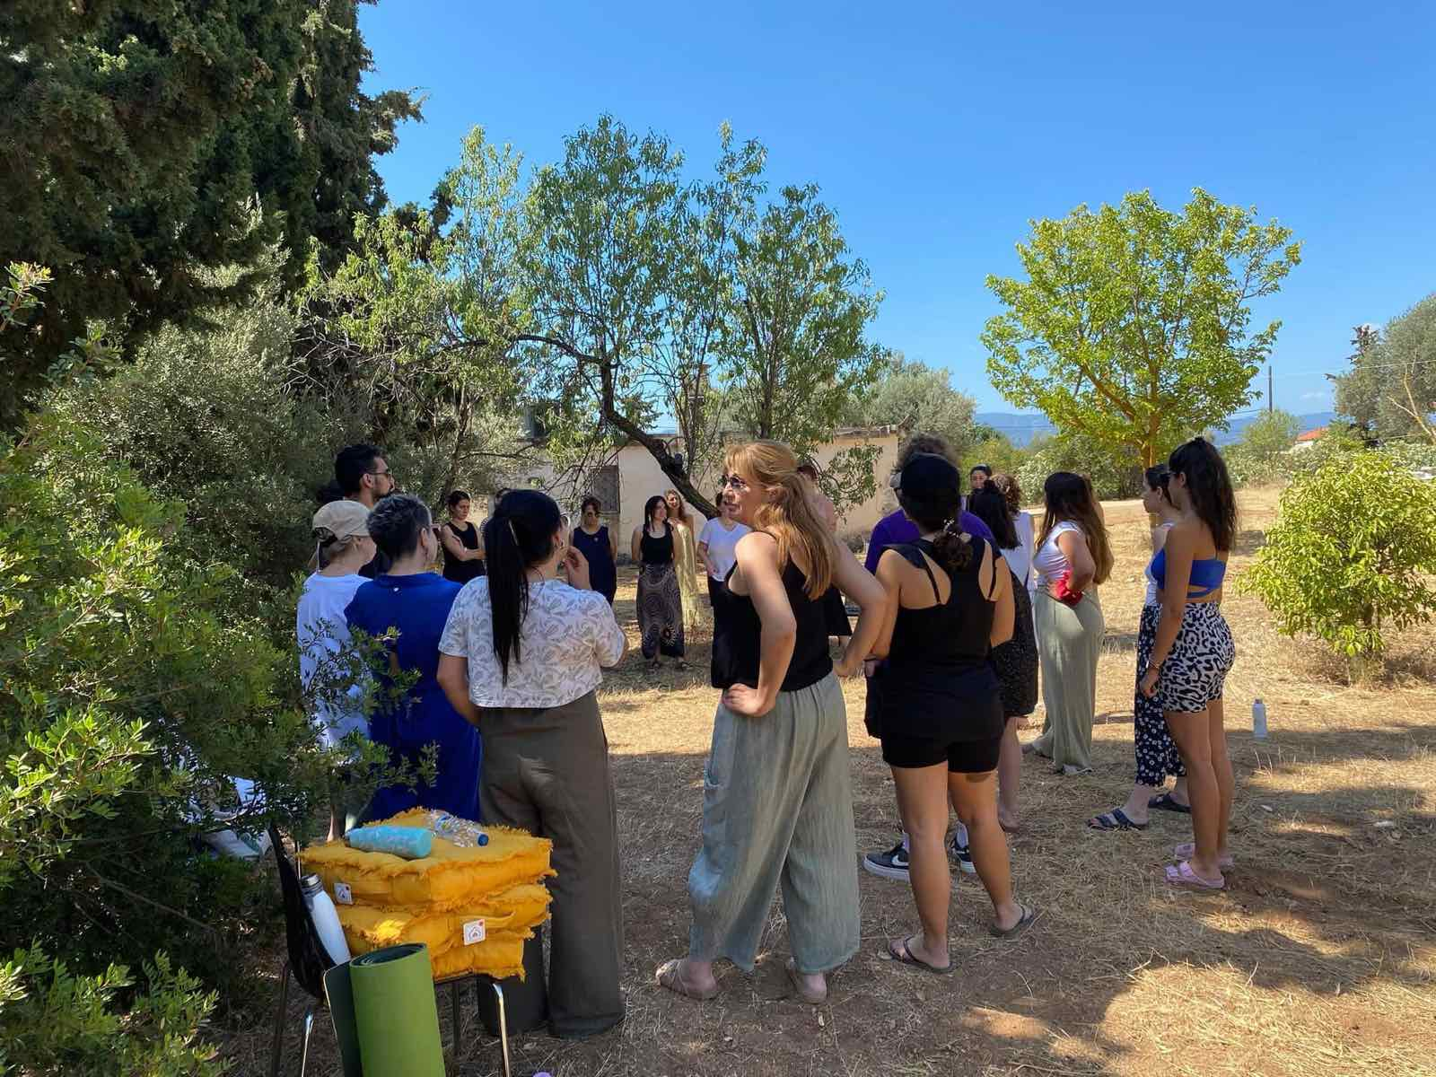
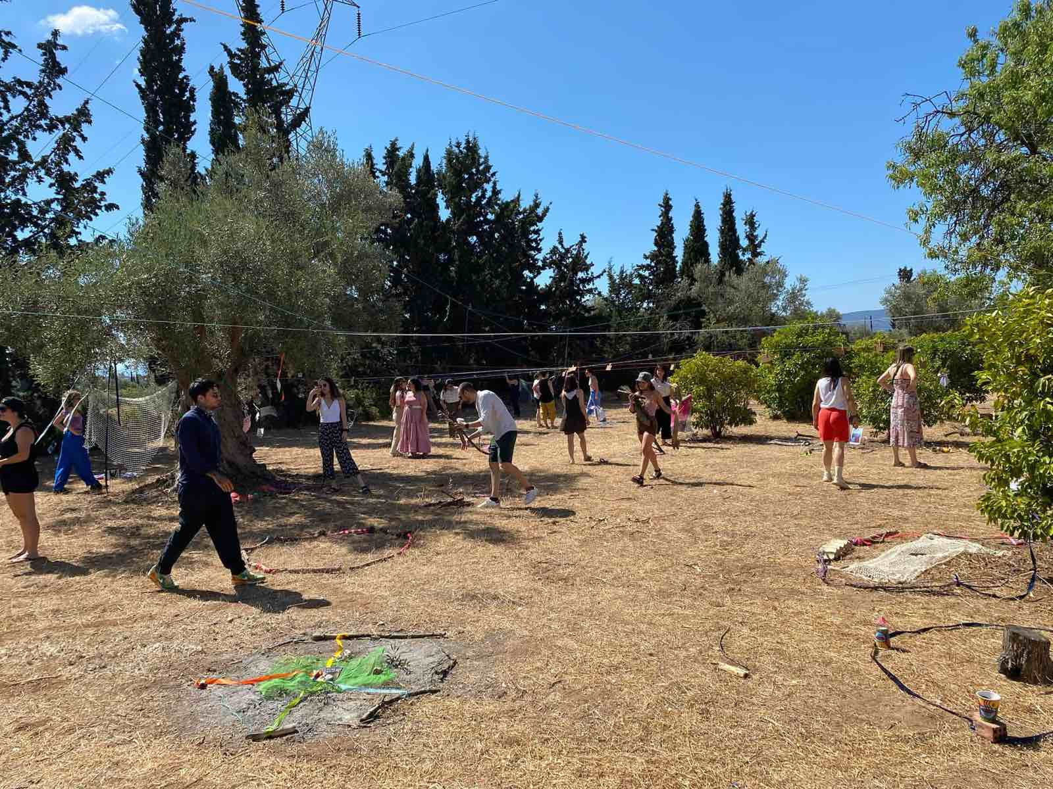
Applied inclusion
in a systemic Centre

Slide 34
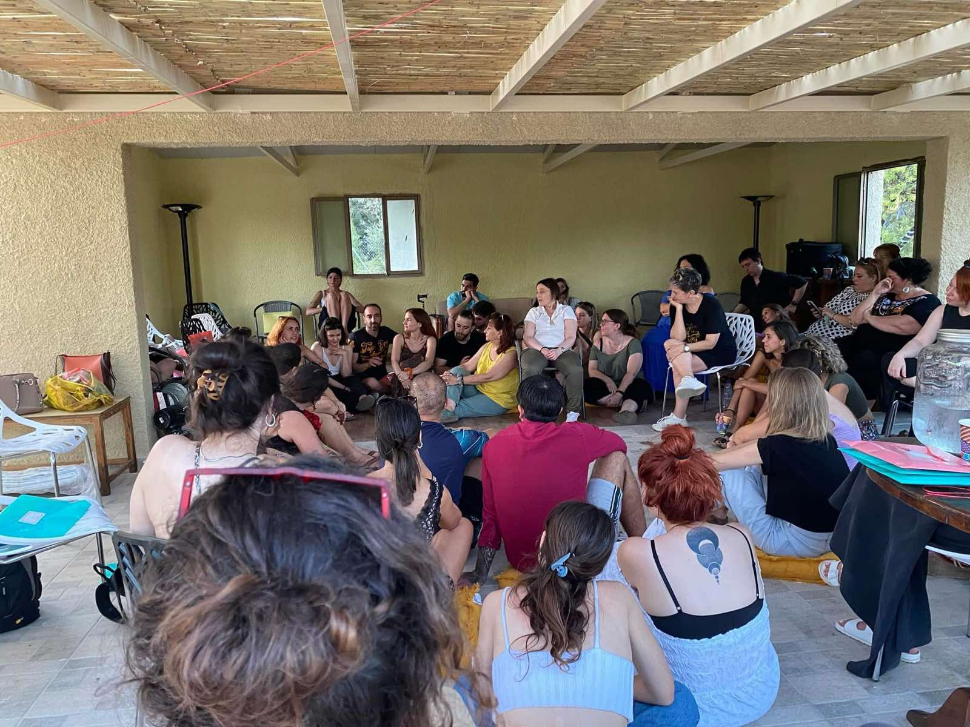
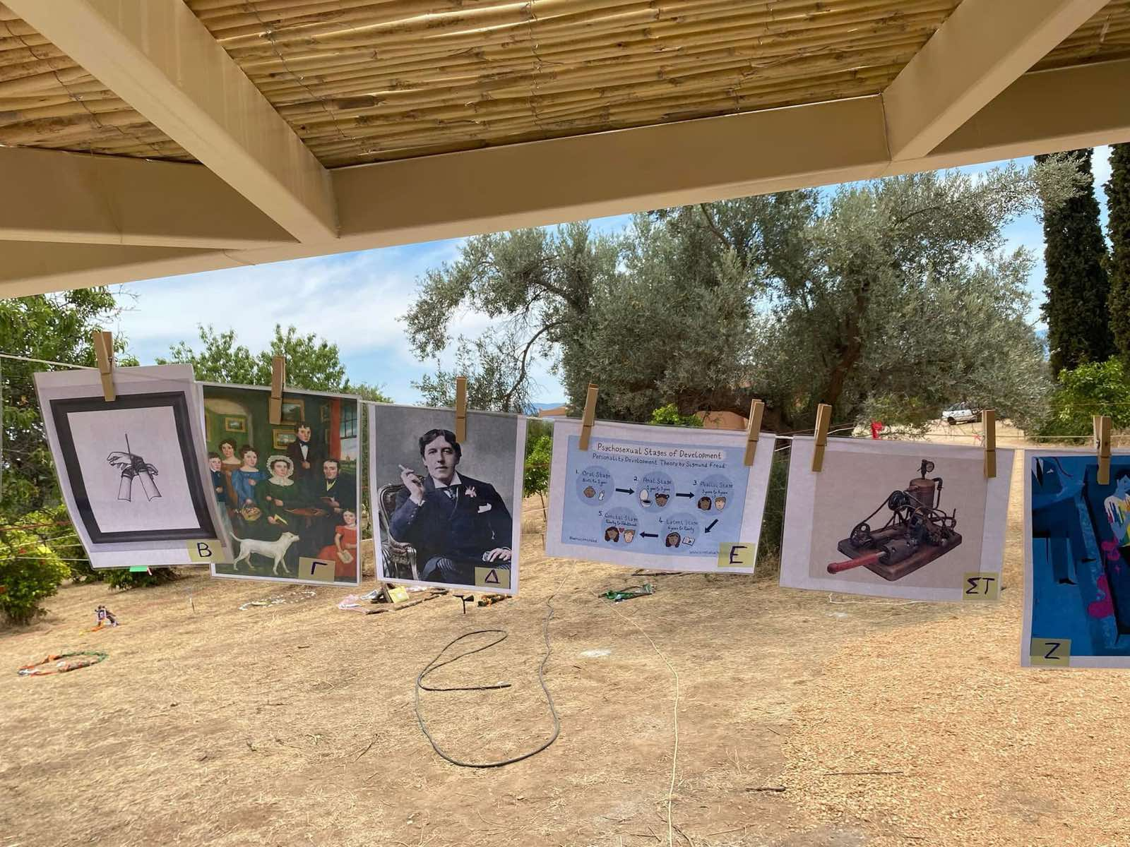
Applied inclusion
in a systemic Centre

Slide 35
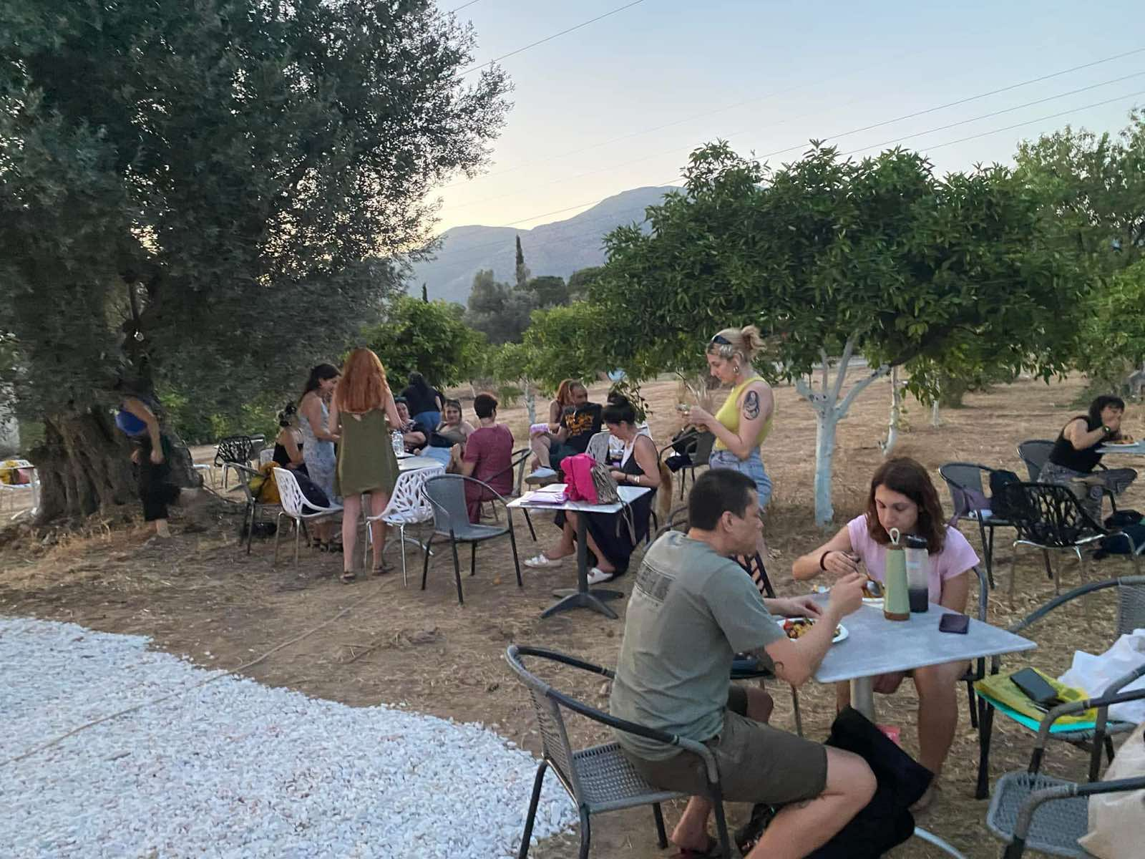
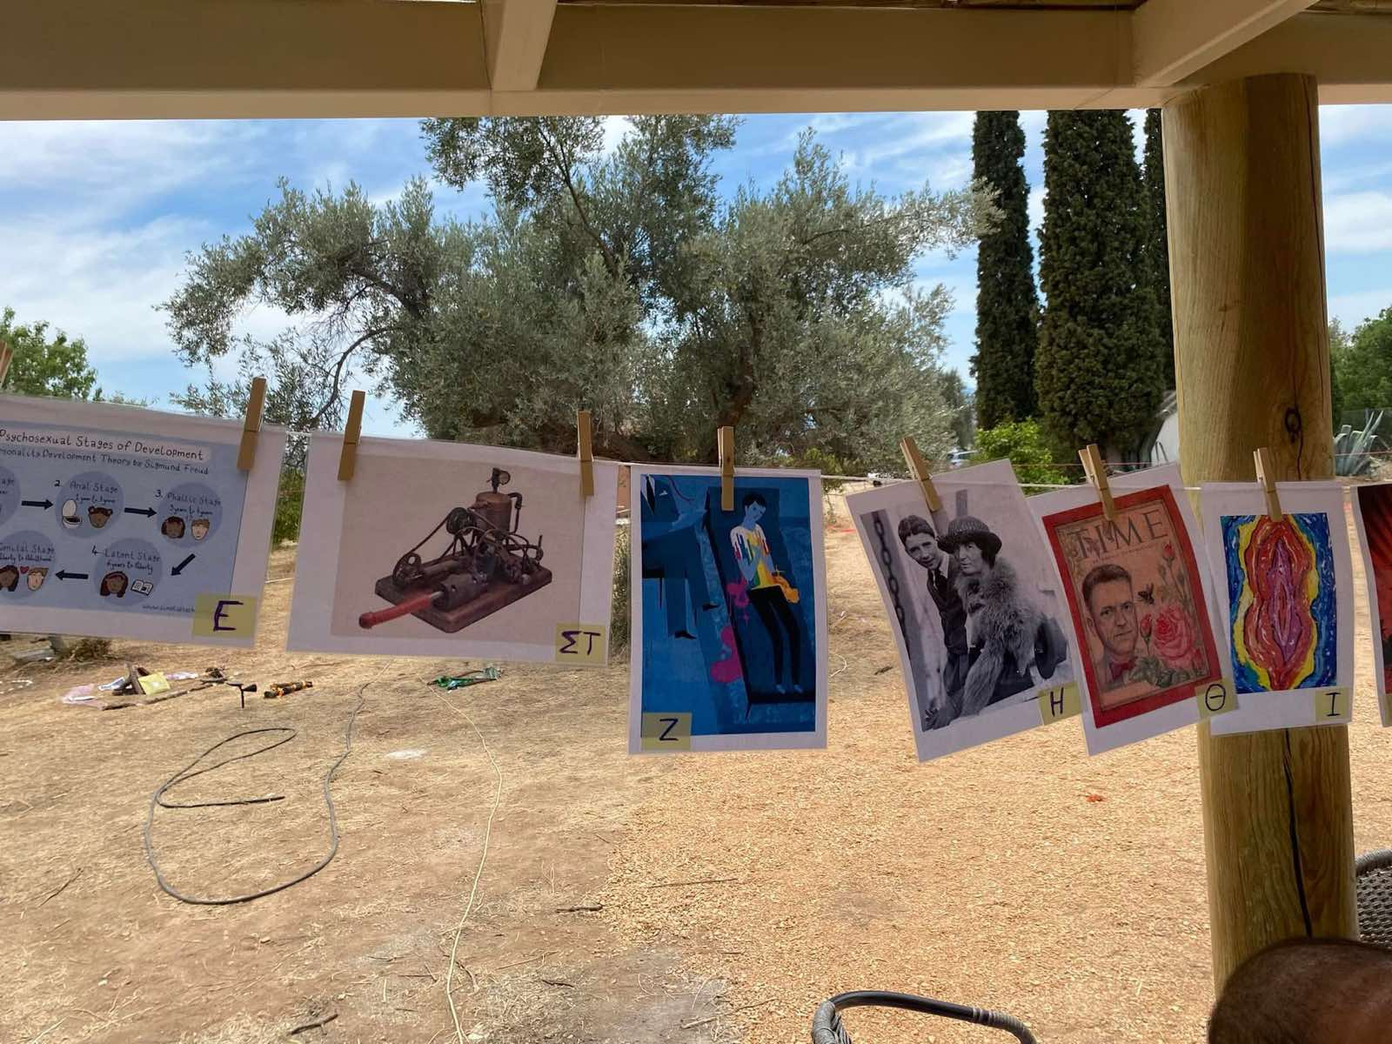
Applied inclusion
in a systemic Centre

Slide 36
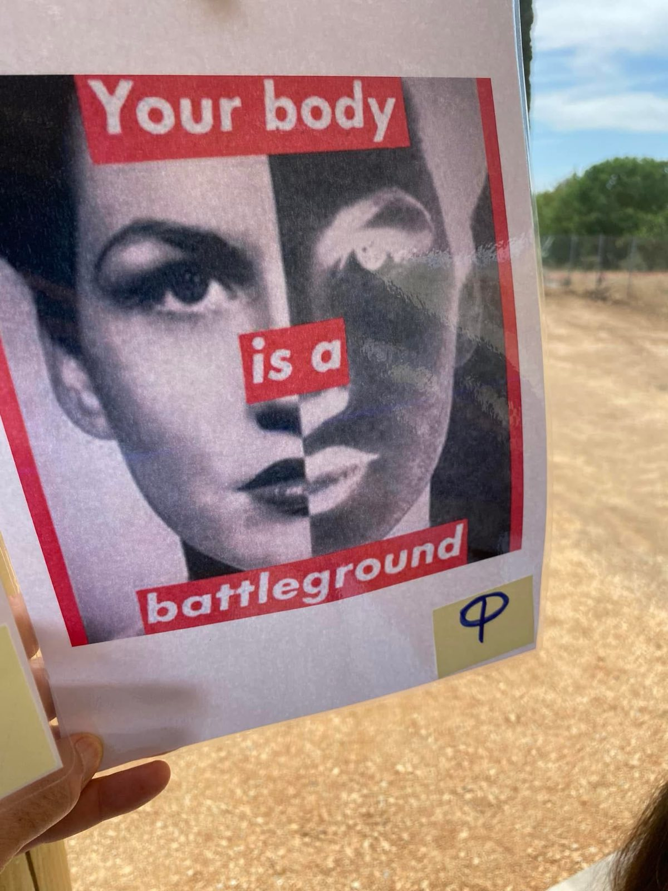
Applied inclusion
in a systemic Centre

Slide 37

Applied inclusion
in a systemic Centre
Comprehensive Sexuality Education (CISE)
The overall approach is grounded in contemporary scientific knowledge and founded on Human Rights, the Rights of the Child, and the international and European guidelines on Sexuality Education (WHO, UNESCO, SIECUS, among others).
At the same time, it is sex-positive, inclusive, affirmative, and trauma-informed. It acknowledges the importance of intersectionality, embodied experience, and empathy as essential elements in cultivating caring and safe relationships.
This approach embraces the diversity of desire and expression, so that all individuals may feel proud of their uniqueness. It supports sexual agency and aims for gender equality and the inclusion of all forms of otherness.

Slide 38
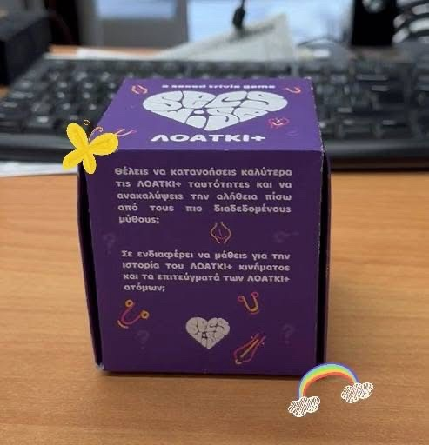

Applied inclusion
in a systemic Centre
Project SecsWise
A digital and physical learning tool that approaches sexuality from a positive perspective. It includes an online learning environment, accessible to all in both Greek and English, and a physical card game that enables groups to learn collectively through play and fun. The questions explore topics around sexuality, sex, gender, and relationships.
Project SecsWise is based on valid, up-to-date scientific data on Sexual Health, Sexual and Reproductive Rights, and embraces a sex-positive approach. It challenges heteronormativity and highlights the importance of diversity and inclusion. It follows the guidelines of UNESCO and the World Health Organization for Comprehensive Sexuality Education (CSE). SecsWise focuses on both the individual and the wider world, viewing happiness as both a personal and a collective achievement.

Slide 39
Applied inclusion
in a systemic Centre
“Human existence unfolds within dialogue, wherein one participates not solely through language but also through the body, the spirit, ideas, and actions. In the final analysis, the very existence of a person may itself be conceived as ‘dialogue’ (Dufva 1998; Bakhtin 1981; Karatsinidou 2006, p. 75).”

Slide 40

THANK
YOU

